Slide 1











DIGITAL CLOCK
Logic design
Under Supervisors:
Dr. Ahmed Ayoup Dr. Haitham

Slide 2


Outline
01
1) Idea, motivation and Problem State, Merits of the project.
02
03
2) Part list and Schematic of project.
3) Mechanical Parts.
04
05
4) Code and simulation of project .
5) Future work and Appendix

Slide 3

Project Vision and Motivation
The main idea of this project is to build a simple digital clock using an Arduino. The clock will show the current time using a display, and it will keep track of time accurately with the help of a Real-Time Clock (RTC) module.
The motivation for this project comes from the goal of applying logical design concepts to something practical and useful. Digital clocks are devices we see every day, and creating one helps us understand how time is measured, stored, and shown using digital systems.

Slide 4

1
Time Format:
Problem statement of project
Old Code: 12-hour format with AM/PM toggle.
New Code: 24-hour format (goes from 0 to 23).
2
Button Handling:
Old Code: Buttons for adjusting hours, minutes, and toggling AM/PM.
New Code: Buttons for adjusting hours, minutes, and resetting seconds. No AM/PM toggle.
3
Full Reset:
Old Code: Seconds, minutes, and hours reset as needed.
New Code: Only resets seconds (doesn't reset hours or minutes).

Slide 5
Future work and Improvement
1.Problems with Logic Gates
2. Components Burning in Tinkercad
At first, we had trouble setting up the logic gates correctly. It took us time to understand how to make the right connections and get the expected results.
While testing the circuit on Tinkercad, some parts kept "burning" or not working properly. This was usually because of wrong connections or voltage issues, and we had to fix the wiring many times.
3. Pushbutton Confusion
4 . Using a Regular LCD Instead of I2C
We started with 2-pin pushbuttons, which were hard to wire correctly. Later, we switched to 4-pin buttons, which were easier to connect and gave better results.
We chose a normal 16x2 LCD instead of an I2C one to have more control over the display. But this meant using more wires and Arduino pins, which made the setup harder to manage.

Slide 6
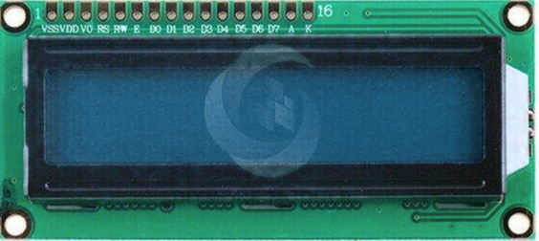
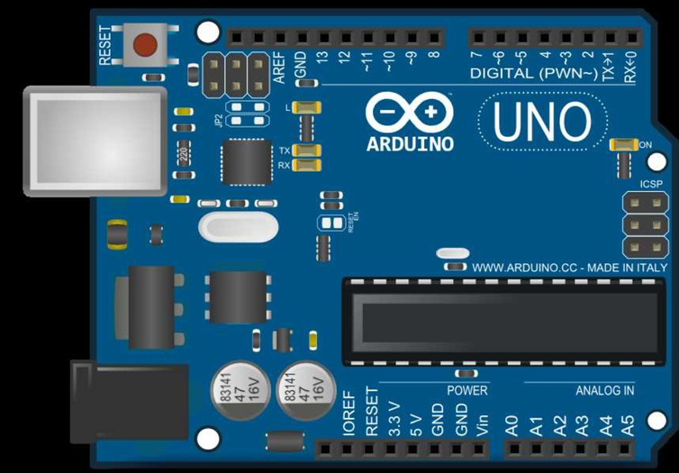

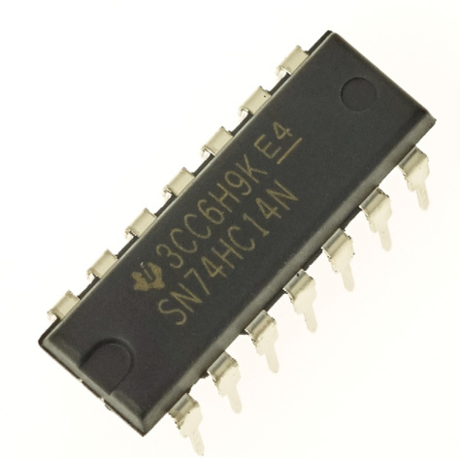
Parts list and Schematic of project
•Arduino Uno
• R3LCD 16 x 2
•1 kΩ Resistor (×4)
•220 Ω Resistor (×1)
•Pushbutton (×3)
•Inverting Schmitt Trigger (74HC14)
Buzzer (Passive or Active)

Slide 7
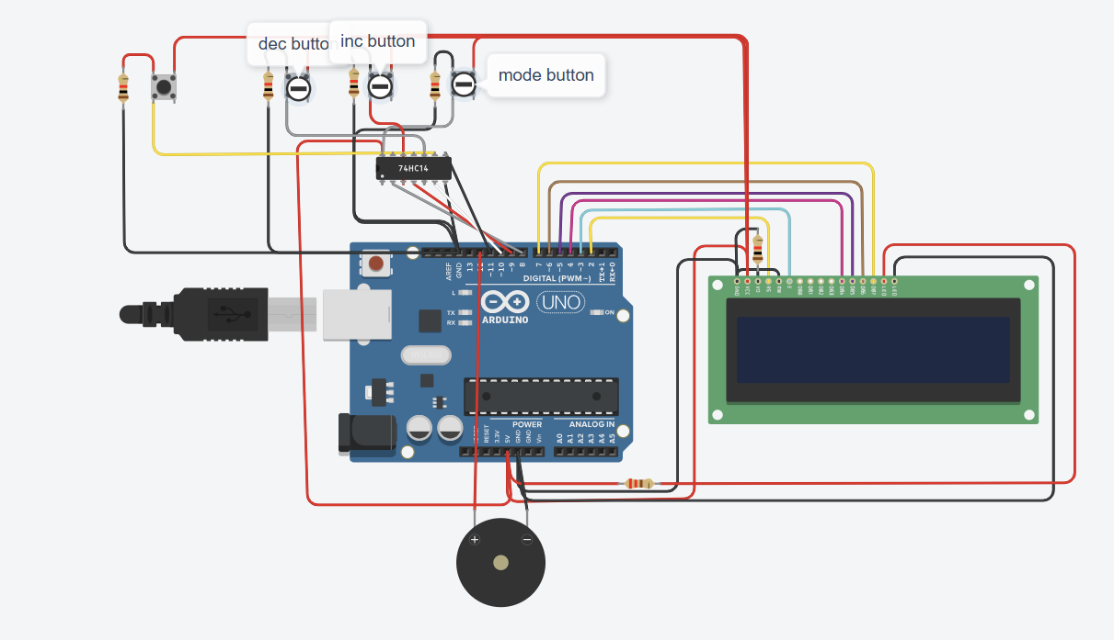
Mechanical Parts
•Arduino Uno
• R3LCD 16 x 2
•1 kΩ Resistor (×4)
•220 Ω Resistor (×1)
•Pushbutton (×3)
•Inverting Schmitt Trigger (74HC14)
Buzzer (Passive or Active)

Slide 8

#include <LiquidCrystal.h>
#include <EEPROM.h>
// LCD Pins
LiquidCrystal lcd(2, 3, 4, 5, 6, 7);
// Button Pins
#define MODE_BUTTON 8
#define INC_BUTTON 9
#define DEC_BUTTON 10
#define ALARM_TOGGLE 11
#define BUZZER_PIN 12
// Variables
int hours, minutes, seconds;
bool isPM;
int alarmHours = 7, alarmMinutes = 0;
bool alarmIsPM = false;
bool alarmEnabled = false;
bool alarmTriggered = false;
int adjustMode = 0;
// 0=Normal, 1=Hour, 2=Minute, 3=AM/PM, 4=Alarm Hour, 5=Alarm Minute, 6=Alarm AM/PM
//Date and Day
const char* currentDate = "29/04/2025";
const char* currentDay = "Tue"
// Timing
unsigned long lastUpdate = 0;
unsigned long lastButtonPress = 0;
const unsigned long debounceDelay = 100;
unsigned long snoozeUntil = 0;
Code

Slide 9
void setup() {
lcd.begin(16, 2);
pinMode(MODE_BUTTON, INPUT_PULLUP);
pinMode(INC_BUTTON, INPUT_PULLUP);
pinMode(DEC_BUTTON, INPUT_PULLUP);
pinMode(ALARM_TOGGLE, INPUT_PULLUP);
pinMode(BUZZER_PIN, OUTPUT);
hours = EEPROM.read(0);
minutes = EEPROM.read(1);
seconds = EEPROM.read(2);
isPM = EEPROM.read(3);
updateDisplay();
}
void loop() {
unsigned long now = millis();
if (now - lastUpdate >= 800)
lastUpdate = now;
updateTime();
checkAlarm();
updateDisplay();
}
handleButtons();
}
void handleButtons() {
if (millis() - lastButtonPress < debounceDelay) return;
Code

Slide 10
if (digitalRead(MODE_BUTTON) == LOW) {
adjustMode = (adjustMode + 1) % 7;
updateDisplay();
lastButtonPress = millis();
}
if (digitalRead(ALARM_TOGGLE) == LOW) {
if (alarmTriggered) {
snoozeUntil = millis() + 5UL * 60UL * 1000UL;
alarmTriggered = false;
noTone(BUZZER_PIN);
} else {
alarmEnabled = !alarmEnabled;
}
updateDisplay();
lastButtonPress = millis();
}
if (digitalRead(INC_BUTTON) == LOW && adjustMode > 0) {
adjustValue(1);
updateDisplay();
lastButtonPress = millis();
}
if (digitalRead(DEC_BUTTON) == LOW && adjustMode > 0) {
adjustValue(-1);
updateDisplay();
lastButtonPress = millis();
}
}
Code

Slide 11
void updateTime() {
seconds++;
if (seconds >= 60) {
seconds = 0;
minutes++;
if (minutes >= 60) {
minutes = 0;
hours++;
if (hours > 12) {
hours = 1;
isPM = !isPM;
}
}
}
EEPROM.write(0, hours);
EEPROM.write(1, minutes);
EEPROM.write(2, seconds);
EEPROM.write(3, isPM ? 1 : 0);
}
void checkAlarm() {
if (alarmEnabled && !alarmTriggered && millis() > snoozeUntil) {
if (hours == alarmHours && minutes == alarmMinutes && isPM == alarmIsPM && seconds == 0) {
alarmTriggered = true;
}
}
if (alarmTriggered) {
digitalWrite(BUZZER_PIN, HIGH);
lcd.display();
} else {
digitalWrite(BUZZER_PIN, LOW);
lcd.display();
}
}
Code

Slide 12
void adjustValue(int change) {
switch (adjustMode) {
case 1:
hours += change;
if (hours > 12) hours = 1;
if (hours < 1) hours = 12;
break;
case 2:
minutes += change;
if (minutes >= 60) minutes = 0;
if (minutes < 0) minutes = 59;
seconds = 0;
break;
case 3:
isPM = !isPM;
break;
case 4:
alarmHours += change;
if (alarmHours > 12) alarmHours = 1;
if (alarmHours < 1) alarmHours = 12;
break;
case 5:
alarmMinutes += change;
if (alarmMinutes >= 60) alarmMinutes = 0;
if (alarmMinutes < 0) alarmMinutes = 59;
break;
case 6:
alarmIsPM = !alarmIsPM;
break;
}
}
void updateDisplay() {
lcd.clear();
lcd.setCursor(0, 0);
if (hours < 10) lcd.print("0");
lcd.print(hours);
lcd.print(":");
if (minutes < 10) lcd.print("0");
lcd.print(minutes);
lcd.print(":");
if (seconds < 10) lcd.print("0");
lcd.print(seconds);
lcd.print(isPM ? " PM" : " AM");
Code

Slide 13
if (adjustMode > 0) {
lcd.setCursor(0, 1);
switch (adjustMode) {
case 1:
lcd.print("Set Hour [+][-]");
break;
case 2:
lcd.print("Set Min [+][-]");
break;
case 3:
lcd.print("Set AM/PM [+]");
break;
case 4:
lcd.print("Alm Hour [+][-]");
break;
case 5:
lcd.print("Alm Min [+][-]");
break;
case 6:
lcd.print("Alm AM/PM [+]");
break;
default:
lcd.print("Time Mode");
break;
}
}
}
lcd.setCursor(0, 1);
lcd.print(currentDay);
lcd.print(" ");
lcd.print(currentDate);
if (alarmEnabled) {
lcd.setCursor(10, 1);
lcd.print("ALM");
lcd.print(" ");
if (alarmHours < 10) lcd.print("0");
lcd.print(alarmHours);
lcd.print(":");
if (alarmMinutes < 10) lcd.print("0");
lcd.print(alarmMinutes);
lcd.print(alarmIsPM ? "PM" : "AM");
}
Code

Slide 14
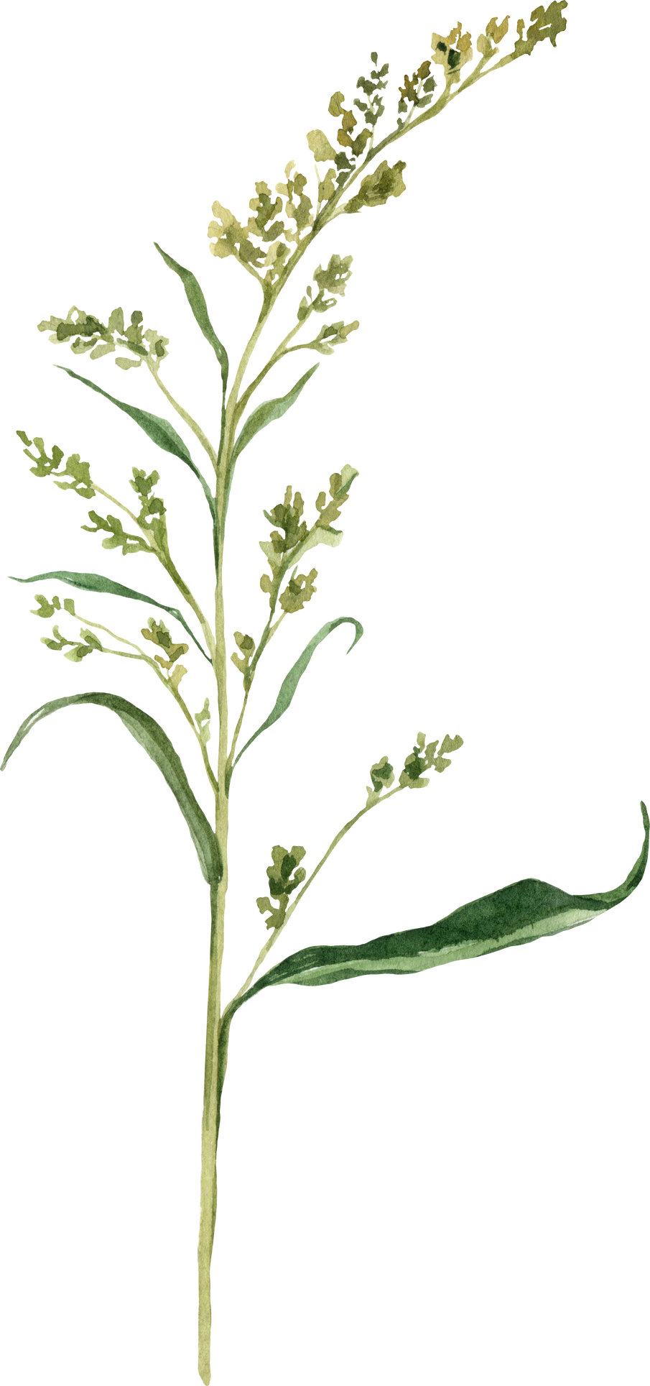
1. Mariam Abdallah Mohamed _692400624 _E1
2. Malak Emad Abdelnabie_ 692400649 _E1
3. Nourhan Hamed Serageldin _692400663 _E1
4. Abdallah Emad Ragab 692400175 D1
5. Mohamed Osama Ahamed _692400638_E1
6. Ahmed Waled Shawky_622400006_B3
7. Mohamed Tarek Abdelaziz _692400158_C5
8. Gamal Sayed Mohamed _692400633_G1
9. Begad Sameh Salah_692400620_E1
10. Ziad Emad _692400574 _D4
11. Yasmine Yasser Motawe _ 692400099_A5
12. Mohamed Ayman Ahmed_692400560_D2
13. Mohamed Mahmoud Mohamed_692400363_C3
14. Ahmed Samy Mohamed_ 692400458_ E1
15. Youssef Ahmed Mostafa Hawary_692400157_D1
16. Mohamed Faisal Mohamed _692400112_D3
17. Nancy Hussein Morsy_692400618_A3
18. Seif Eldeen Ahmed_692400509 _E1
19 .Yassin Amr Mohamed_692400629_E2
20. Hossam Mohamed_692400581_B5
Team Names

Slide 15

The appendix
LCD 16x2 display connected to digital pins on the Arduino Uno
Pushbuttons connected to digital inputs, with pull-down resistors (1kΩ)
220Ω resistor used for the buzzer or as a current limiter for an LED if included
Schmitt Trigger (74HC14) used for debouncing button inputs or signal conditioning
Buzzer (active or passive) for alarm or timer notification
The Schmitt Trigger (74HC14) ensures clean, noise-free button presses by shaping input signals.
Pushbuttons can be programmed to adjust the clock settings (e.g., set hour, minute, reset).
The buzzer can be used for a basic alarm or to confirm time-setting actions.
The LCD displays the time clearly and updates continuously in the loop()

Slide 16
TA Esraa,
Thank you so much for helping us with the project! Your support made a difference, and we’re grateful for your time and effort. It made things a lot easier and less stressful.
Thanks again for everything!

Slide 17
Thank
You

